Slide 1

SIT1305- MACHINE LEARNING
Course In-Charges:
Dr.A.Mary Posonia
Dr.B.Ankayarkanni
SIT1305 Machine Learning

Slide 2
When to Consider Supervised Learning
  Takes a known set of input data (the training set) and known responses to the data (output), and trains a model to generate reasonable predictions for the response to new input data.
  Use supervised learning if you have existing data for the output you are trying to predict.
When to Consider Unsupervised Learning
  Useful when you want to explore your data but don’t yet have a specific goal or are not sure what information the data contains.
  It’s also a good way to reduce the dimensions of your data.
SIT1305 Machine Learning

Slide 3
Examples of Machine Learning Applications
Tasks are classified into two categories:
1. Descriptive- characterize the properties of data
2. Predictive – Inference on current data to make predictions
Functionalities:
1.Class/Concept Description
2. Associations
3.Classification and Prediction
4.Clustering
5.Outliers
SIT1305 Machine Learning

Slide 4
1.Class/Concept Description
Class/Concept refers to the data to be associated with the classes or concepts.
  Data Characterization − This refers to summarizing data of class under study. This class under study is called as Target Class.
  Data Discrimination − It refers to the mapping or classification of a class with some predefined group or class.
SIT1305 Machine Learning

Slide 5
2. Associations
Find frequent elements/items
Find the associations between them/relationships
Single dimensional association rule
Buys(‘X’, ‘Computer’) → Buys(‘X’, ‘Software’)
Multidimensional association rule
Age(‘X’, ’40-60’) and income(‘X’, ’50-60 lakhs’) → Buys(‘X’, ‘Computer’)
Algorithms:
  Apriori
  Frequent pattern growth tree
SIT1305 Machine Learning

Slide 6
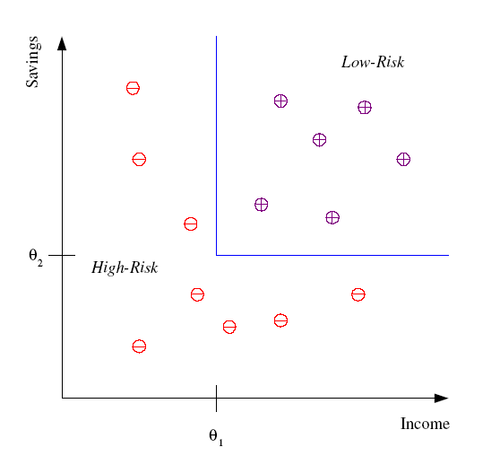
Classification
Example: Credit scoring
Differentiating between low-risk and high-risk customers from their income and savings
Discriminant: IF income > θ₁ AND savings > θ₂
THEN low-risk ELSE high-risk
Model
SIT1305 Machine Learning

Slide 7
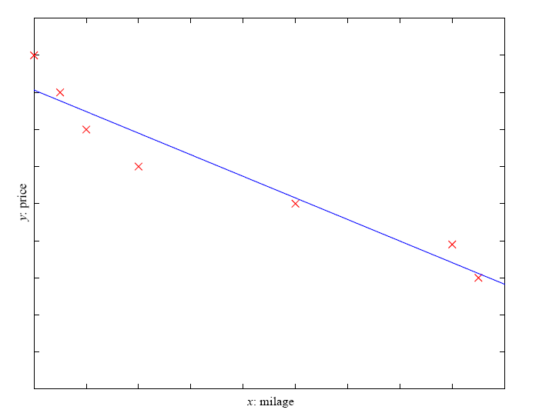
Prediction: Regression
Example: Price of a used car
x : car attributes
y : price
y = g (x | θ )
g ( ) model,
θ parameters
y = wx+w₀
SIT1305 Machine Learning

Slide 8
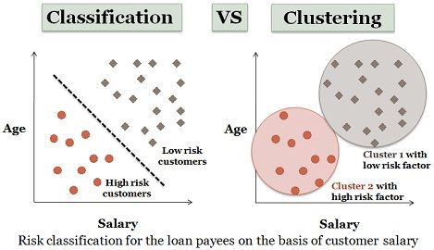
SIT1305 Machine Learning

Slide 9
Learning Associations
Imagine that you are a sales manager at AllElectronics, and you are talking to a customer who recently bought a PC and a digital camera from the store. What should you recommend to her/him next?
Frequent patterns and association rules are the knowledge that you want to mine in such a scenario.
Finding frequent patterns plays an essential role in mining associations, correlations, and many other interesting relationships among data.
Moreover, it helps in data classification, clustering, and other data mining tasks.
SIT1305 Machine Learning

Slide 10
What is Association Mining?
Motivation: finding regularities in data
  What products were often purchased together?
  What are the subsequent purchases after buying a PC?
  What kinds of DNA are sensitive to this new drug?
  Can we automatically classify web documents?
SIT1305 Machine Learning

Slide 11
Frequent patterns are patterns that appear frequently in a data set.
  a set of items, such as milk and bread, that appear frequently together in a transaction data set is a frequent itemset.
  A subsequence,such as buying first a PC, then a digital camera, and then a memory card, if it occurs frequently in a shopping history database, is a (frequent) sequential pattern.
  A substructure can refer to different structural forms, such as subgraphs, subtrees, or sublattices, which may be combined with itemsets or subsequences.
    If a substructure occurs frequently, it is called a (frequent) structured pattern.
SIT1305 Machine Learning

Slide 12
Association Rules
An association rule is an implication of the form X → Y where
X is the antecedent and Y is the consequent of the rule.
To find the dependency between two items X and Y.
  P (Y | X ) probability that somebody who buys X also buys Y
  where X and Y are products/services.
SIT1305 Machine Learning

Slide 13
Example Association Rule
90% of transactions that purchase bread and butter also purchase milk
“IF” part = antecedent
“THEN” part = consequent
“Item set” = the items (e.g., products) comprising the antecedent or consequent
Antecedent and consequent are disjoint(i.e., have no items in common.
Antecedent: bread and butter
Consequent: milk
Confidence factor:90%
SIT1305 Machine Learning

Slide 14
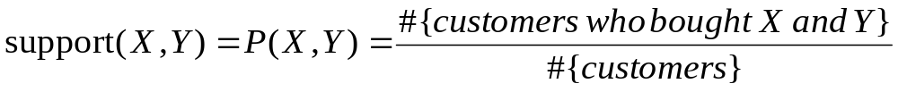
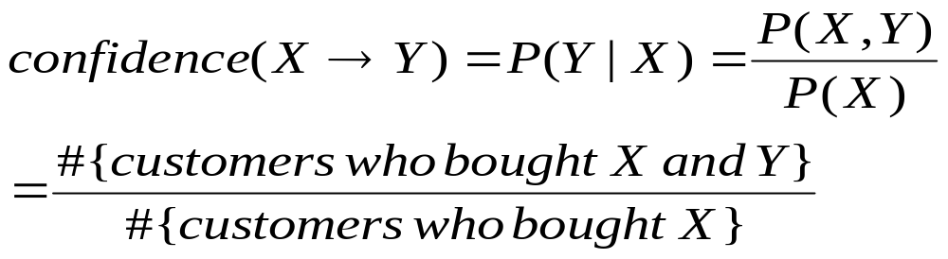
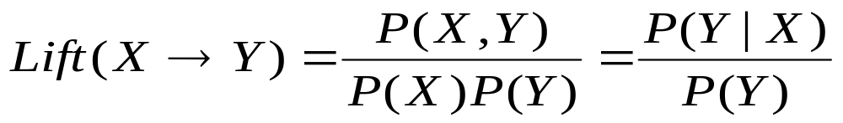
Three measures
Support of the association rule X→Y :
Confidence of the association rule X→Y :
Lift or interest of the association rule X→Y :
Goal:Find all rules that satisfy the user-specified minimum support(min.sup) and minimum confidence(min.conf).
SIT1305 Machine Learning

Slide 15
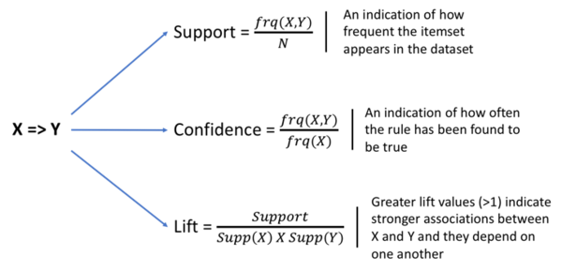
SIT1305 Machine Learning

Slide 16
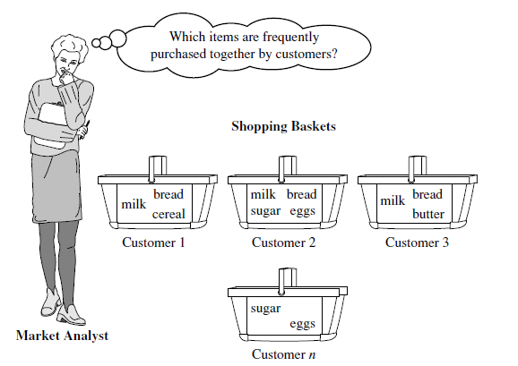
Market Basket Analysis: A Motivating Example
SIT1305 Machine Learning

Slide 17
Market Basket Analysis: A Motivating Example
Market basket analysis, the earliest form of frequent pattern mining for association rules.
Frequent itemset mining leads to the discovery of associations and correlations among items in large transactional or relational data sets.
With massive amounts of data continuously being collected and stored, many industries are becoming interested in mining such patterns from their databases.
Help in many business decision-making processes such as catalog design, cross-marketing, and customer shopping behavior analysis.
SIT1305 Machine Learning

Slide 18
Apriori Algorithm
Proposed by Agrawal et al. in 1996.
Initially used for Market Basket Analysis to find how items purchased by customers are related.
Two steps:
  Finding frequent itemsets, that is ,those which have enough support.
  Converting them to rules with enough confidence, by splitting the items into two, as items in the antecedent and items in the consequent.
SIT1305 Machine Learning

Slide 19
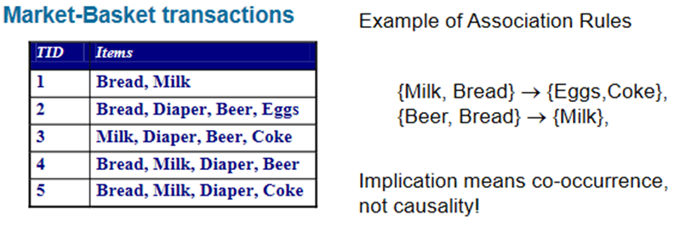
Association rule mining
Given a set of transactions, find rules that will predict the occurrence of an item based on the occurrences of other items in the transaction.
SIT1305 Machine Learning

Slide 20
Transaction data: supermarket data
Market basket transactions:
  t1: {bread, cheese, milk}
  t2: {apple, eggs, salt, yogurt}...
  ...
  tn: {biscuit, eggs, milk}
  Concepts:
    An item: an item/article in a basket
    I:the set of all items sold in the store
    A transaction: items purchased in a basket; it may have TID (transaction ID)
    A transactional dataset: A set of transactions
SIT1305 Machine Learning

Slide 21
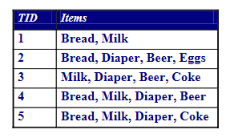
Definition: Frequent Itemset
Itemset
  A collection of one or more items
    Example: {Milk, Bread, Diaper}
  k-itemset
    An itemset that contains k items
    Support count (σ)
      Frequency of occurrence of an itemset
      E.g. σ({Milk, Bread,Diaper}) = 2
      Support
        Fraction of transactions that contain an itemset
        E.g. s({Milk, Bread, Diaper}) = 2/5
        Frequent Itemset
        An itemset whose support is greater than or equal to a min.support threshold σ({Milk, Bread,Diaper}) = 2
SIT1305 Machine Learning

Slide 22
Frequent Itemset Mining Methods
Apriori Algorithm:
Finding Frequent Itemsets by Confined Candidate Generation.
SIT1305 Machine Learning

Slide 23
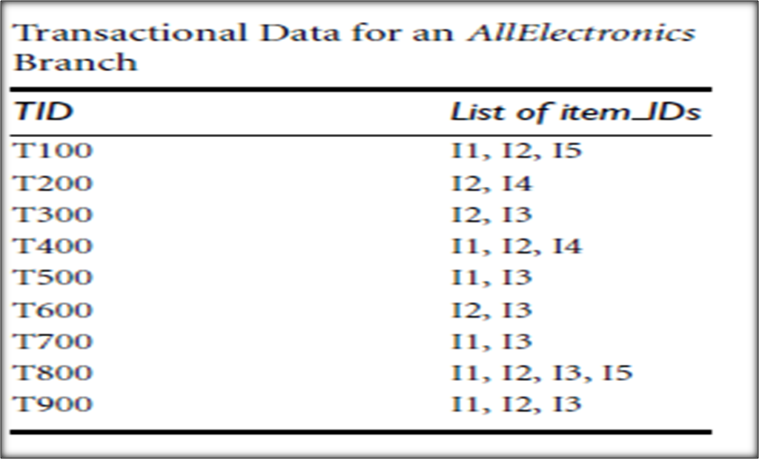
Example
A database has nine transactions ,that is, |D|=9.Minimum support count is 2 and Minimum confidence is 60%.
  a) Find all frequent itemsets using Apriori.
  b) List all the strong association rules (with support s and confidence c).
SIT1305 Machine Learning

Slide 24
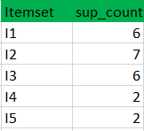
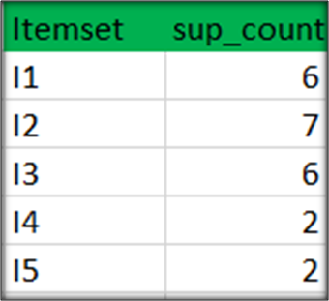
Step-1: K=1
  Create a table containing support count of each item present in dataset – called C1(candidate set)
  compare candidate set item’s support count with minimum support count(given min_support=2). This gives us itemset L1.
C1
L1
SIT1305 Machine Learning

Slide 25
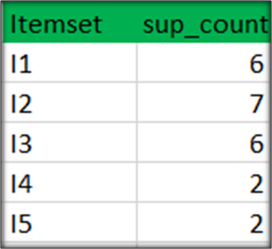
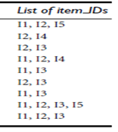
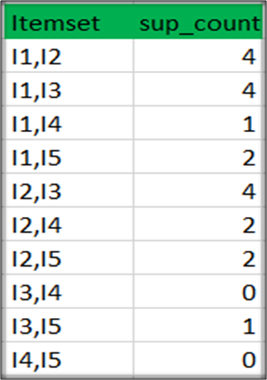
Step-2: K=2
  Generate candidate set C2 using L1 (this is called join step). Condition of joining L_{k-1} and L_{k-1} is that it should have (K-2) elements in common.
  Check all subsets of an itemset are frequent or not and if not frequent remove that itemset.
  Now find support count of these itemsets by searching in dataset.
L1
C2
SIT1305 Machine Learning

Slide 26
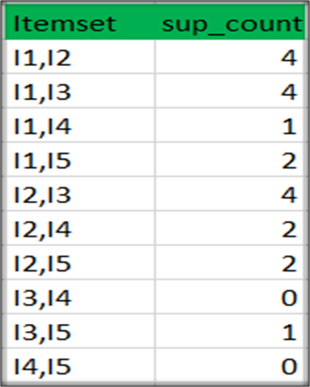
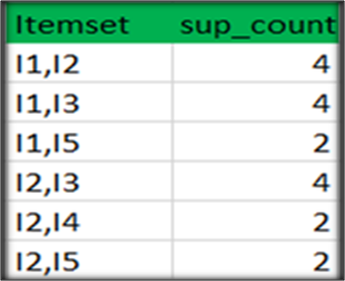
C2
compare candidate (C2) support count with minimum support count,this gives us itemset L2.
L2
SIT1305 Machine Learning

Slide 27
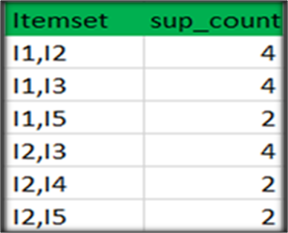
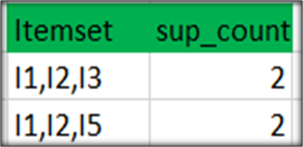
Step-3:
  Generate candidate set C3 using L2 (join step). Condition of joining L_{k-1} and L_{k-1} is that it should have (K-2) elements in common.
  for L2, first element should match.
  Check if all subsets of these itemsets are frequent or not and if not, then remove that itemset.
  (Here subset of {I1, I2, I3} are {I1, I2},{I2, I3},{I1, I3} which are frequent. For {I2, I3, I4}, subset {I3, I4} is not frequent so remove it. Similarly check for every itemset)
  find support count of these remaining itemset by searching in dataset.
Itemset
I1,I2,I3
I1,I2,I5
I1,I2,I4
I1,I3,I5
I2,I3,I4
I2, I3, I5
I2, I4, I5
L2
C3
L3
SIT1305 Machine Learning

Slide 28
Step-4:
Generate candidate set C4 using L3 (join step). Condition of joining L_{k-1} and L_{k-1} (K=4) is that, they should have (K-2) elements in common. So here, for L3, first 2 elements (items) should match.
Check all subsets of these itemsets are frequent or not (Here itemset formed by joining L3 is {I1, I2, I3, I5} so its subset contains {I1, I3, I5}, which is not frequent).
So no itemset in C4.
Stop , because no frequent itemsets are found further.
SIT1305 Machine Learning

Slide 29
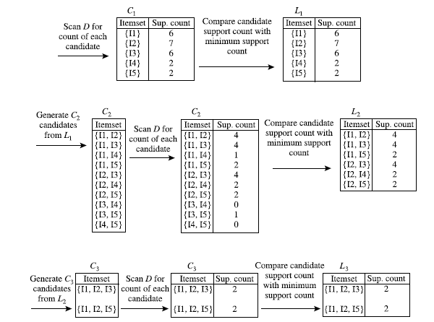
SIT1305 Machine Learning

Slide 30
Generation of strong association rule.
Calculate confidence of each rule.
Confidence
Confidence(A->B)=Support_count(A∪B)/Support_count(A)
SIT1305 Machine Learning

Slide 31

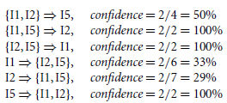
Generating Association Rules
Rule generation for Itemset {I1, I2, I5} from L3
SIT1305 Machine Learning

Slide 32
Rule generation for Itemset {I1, I2, I3} from L3
Rules | Confidence
{I1 ^I2} → I3 | 2/4=0.5=50%
{I2^I3} → I1 | 2/4=0.5=50%
{I1^I3} → I2 | 2/4=0.5=50%
I3→ {I1 ^I2} | 2/5=0.4=40%
I1→ {I2^I3} | 2/6=0.33=33.33%
I2→ {I1^I3} | 2/7=0.28=28%
As the given threshold or minimum confidence is 60%, no rules can be considered as the strong association rules for the given problem.
SIT1305 Machine Learning

Slide 33
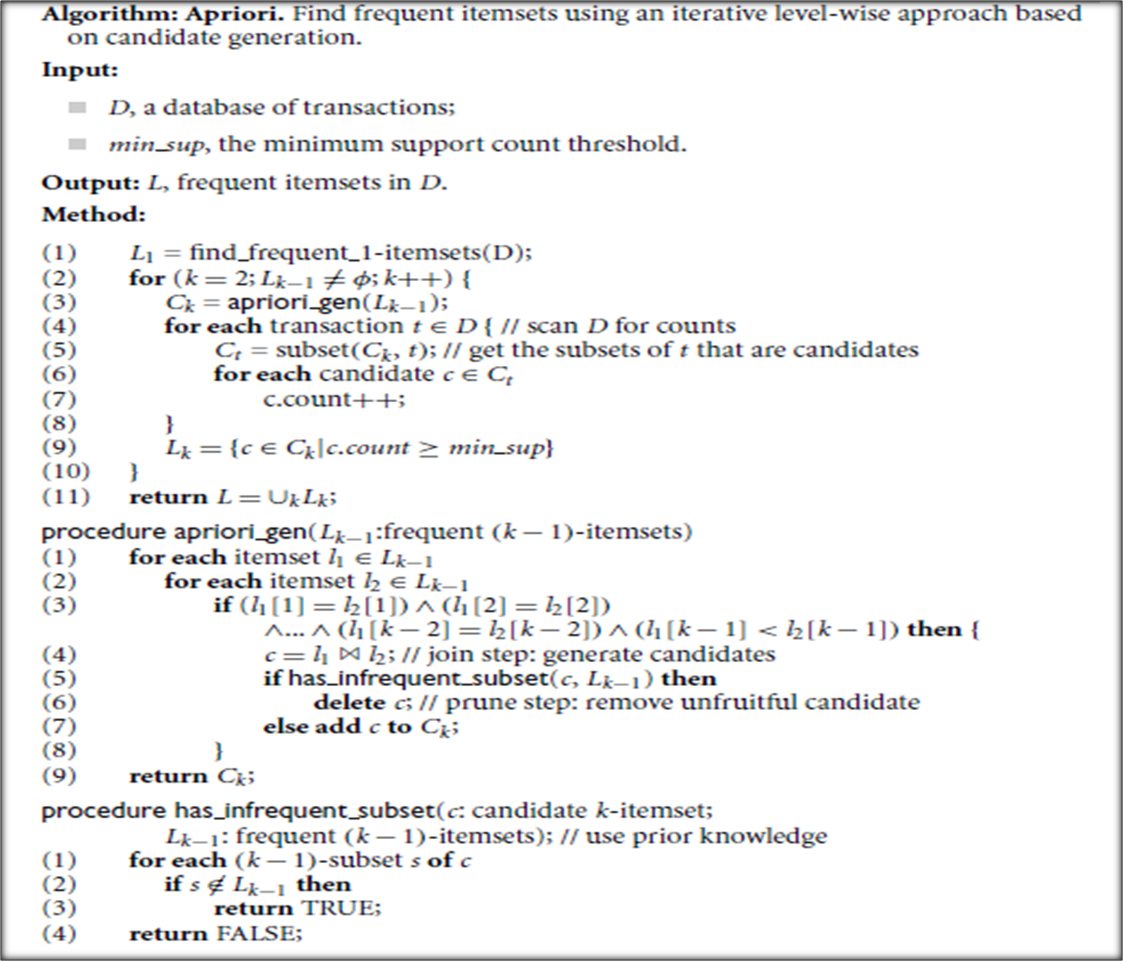
SIT1305 Machine Learning

Slide 34
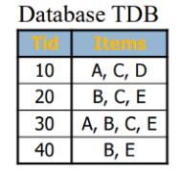
Example 2
SIT1305 Machine Learning

Slide 35
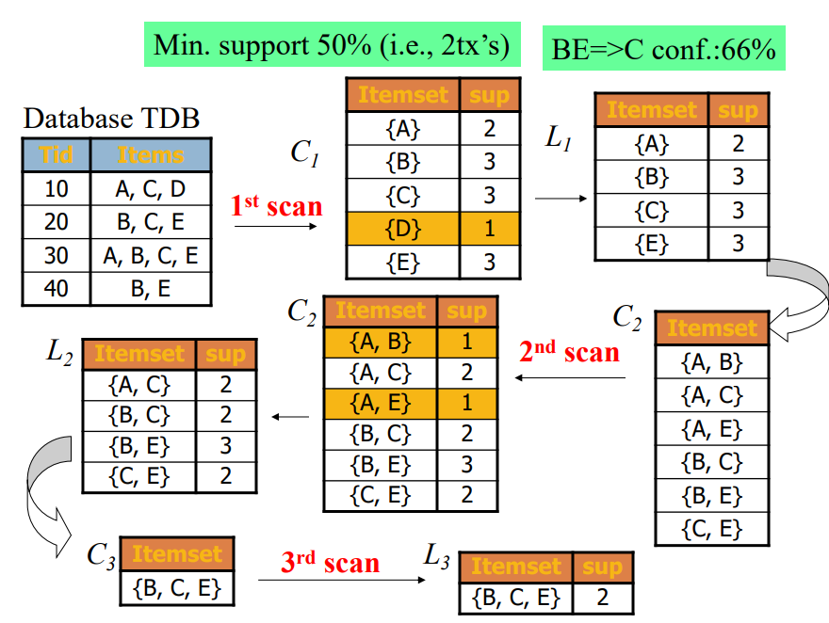
SIT1305 Machine Learning

Slide 36
Advantages of Apriori Algorithm
  This is easy to understand algorithm.
  The join and prune steps of the algorithm can be easily implemented on large datasets.
Disadvantages of Apriori Algorithm
  The apriori algorithm works slow compared to other algorithms.
  The overall performance can be reduced as it scans the database for multiple times.
  The time complexity and space complexity of the apriori algorithm is O(2^{D}), which is very high. Here D represents the horizontal width present in the database.
SIT1305 Machine Learning

Slide 37
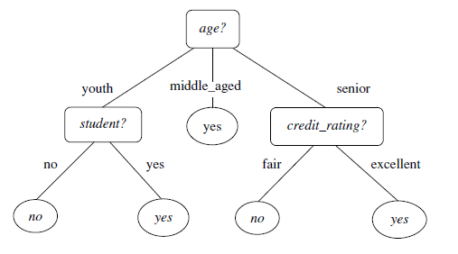
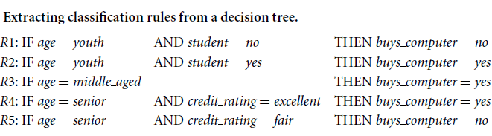
Classification
SIT1305 Machine Learning

